Slide 1
Hot topic
นพ.ศรเจน/อ.ณัฐธพงษ์ อ.นวลวรรณ

Slide 3
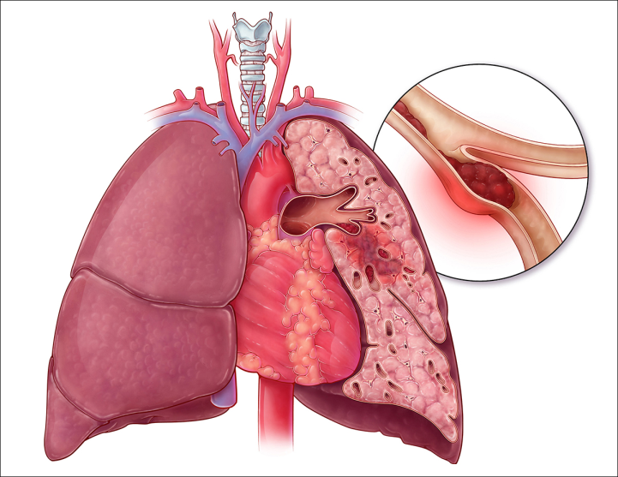
Introduction
Venous thromboembolism(VTE) up to 10% of all hospital-related deaths
VTE mortality rates above than breast cancer, myocardial infarction and stroke

Slide 4
Introduction
Both hospitalization and surgical interventions dramatically increase the risk for VTE
A million women, those having an inpatient surgical procedure were 70 times to be readmitted for a VTE within 6 weeks

Slide 5
Introduction
Perioperative VTE is considered preventable cause of death in hospitalized patients

Slide 6
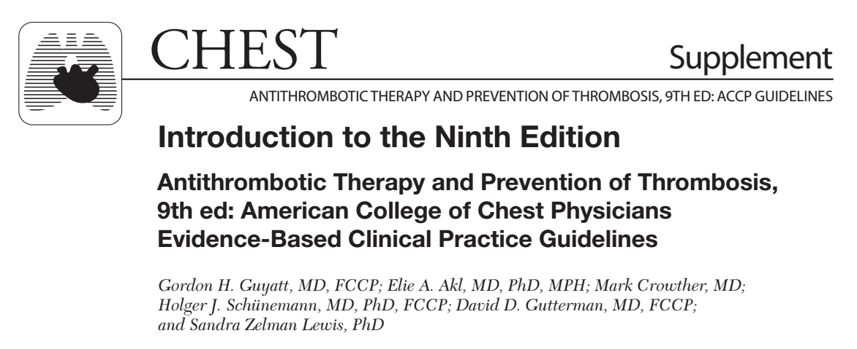
Current guideline

Slide 7
Goal of this article
Concepts in deep venous thrombus formation use as a framework to better evaluate the different treatment options

Slide 8
VTE and surgery
The highest incidence of VTE reported in hip, knee arthroplasty and cancer surgery
70% to 80% of in-hospital deaths due to PE, was not diagnosis prior to the patient’s death

Slide 9
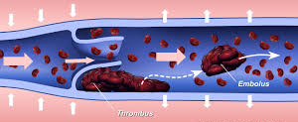
Histological observations
Histological appearance of venous thrombi throughout the various stages of the disease

Slide 10
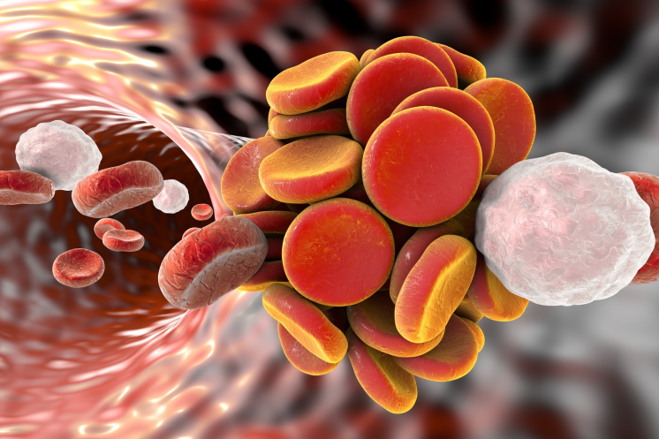
Intravascular thrombi
White clots, contain of platelets, trigger myocardial infarction and stroke
Red clots, contain of red blood cells and fibrin, trigger VTE

Slide 11
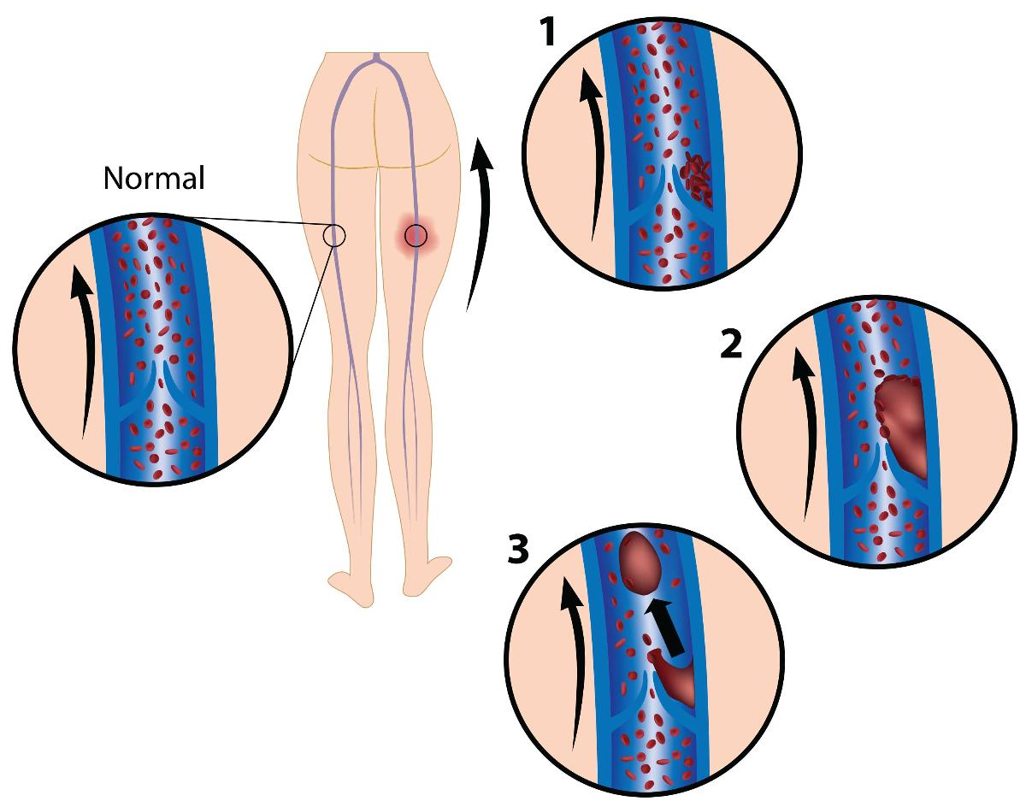
Venous thrombogenesis
Mechanisms of deep vein thrombosis(DVT) formation are critical events in venous thrombogenesis

Slide 12
Venous stasis
Normal peripheral venous flow is required to prevent the accumulation of procoagulants such as thrombin

Slide 13
Normal peripheral venous flow
Continuous venous flow (streamline or laminar flow)
Pulsatile flow

Slide 14
Continuous venous flow
The pressure generated by left ventricular contraction and elastic recoil of the arterial tree, which pushes blood through the capillary beds back to the atrium

Slide 15
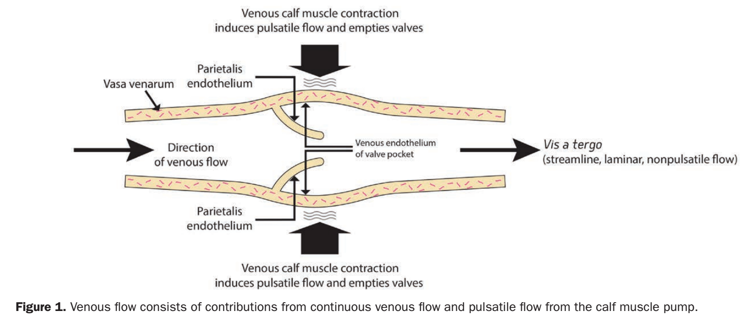
Continuous venous flow

Slide 16
Continuous venous flow
Affected by changes in microvascular resistance and venous pressure
Maintain the prothrombotic and antithrombotic balance by preventing local accumulation of thrombin

Slide 17
Pulsatile flow
Occurs during muscle contraction, when the deep veins are compressed to force blood back to the heart
Pulsatile flow is significantly decreased during bed rest and abolished by general anesthesia

Slide 18
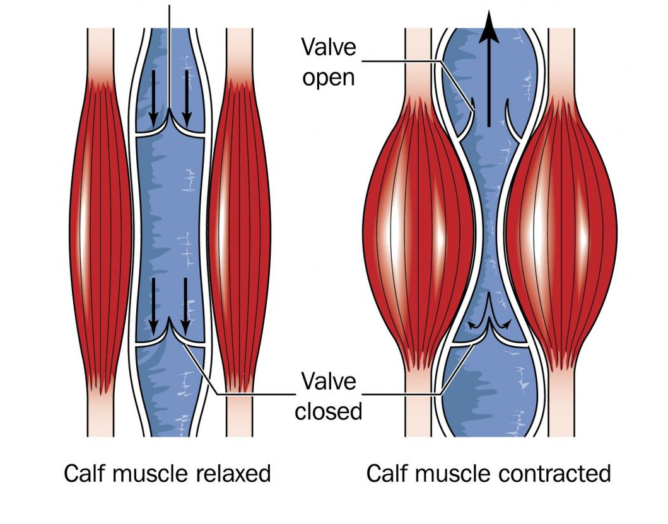
Pulsatile flow

Slide 19
Pulsatile flow
Pulsatile flow is facilitated by venous valves that prevent reflux secondary to gravity
Only pulsatile flow is effective in emptying the venous valve pockets

Slide 20
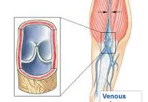
Venous valve
DVT originate in venous sinuses(venous valve)
Risk for developing DVT increases in the number of venous valves

Slide 21
Venous valve endothelium
Venous valve endothelial cell surfaces higher levels of anticoagulant(thrombomodulin) and lower levels of procoagulant(vWF)

Slide 22
Venous valve hypoxia
Oxygen supply above endothelial cells in venous valves are remarkably at risk for hypoxia in the absence of pulsatile flow

Slide 23
Endothelial dysfunction
Hypoxia and subsequent inflammation activate endothelial cells
Downregulate the expression of anticoagulant proteins and upregulate the expression of procoagulant proteins

Slide 24
Endothelial dysfunction
Promote thrombogenesis

Slide 25
Thrombus Initiation: TF Dependent

Slide 27
Thrombus Initiation: TF Dependent
Microvesicles(MVs) play a key role in venous thrombus formation especially in patients with malignancies
Tissue factor(TF) expression by circulating monocytes is significantly increase in patients undergoing total knee arthroplasty

Slide 28
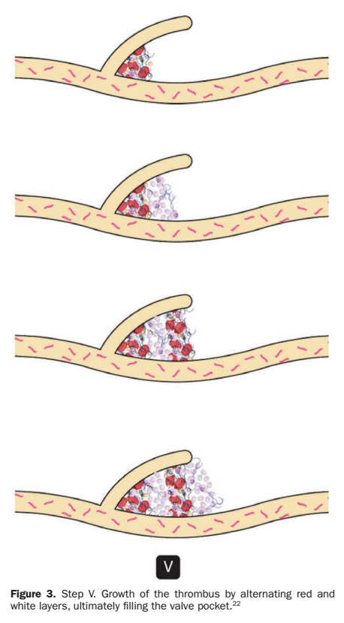
Thrombus Propagation: Platelet and Leukocyte Accumulation
Multiple pathways and different cells types to promote thrombogenic nidus formation and subsequent thrombus propagation

Slide 29
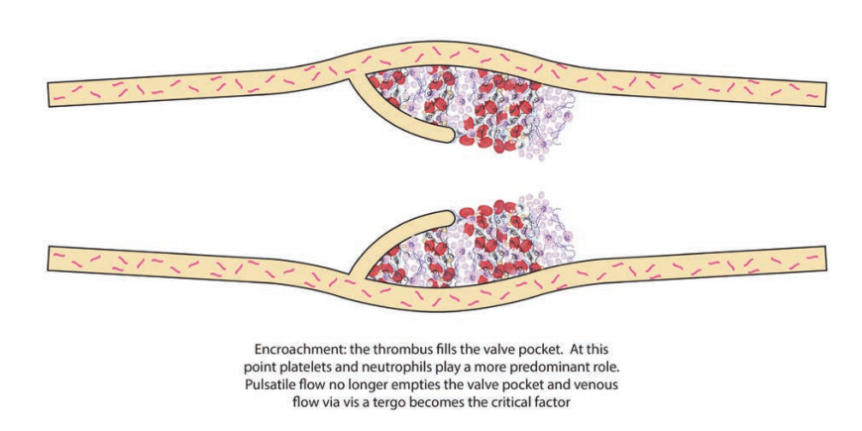
Laminar flow
Pulsatile flow

Slide 30
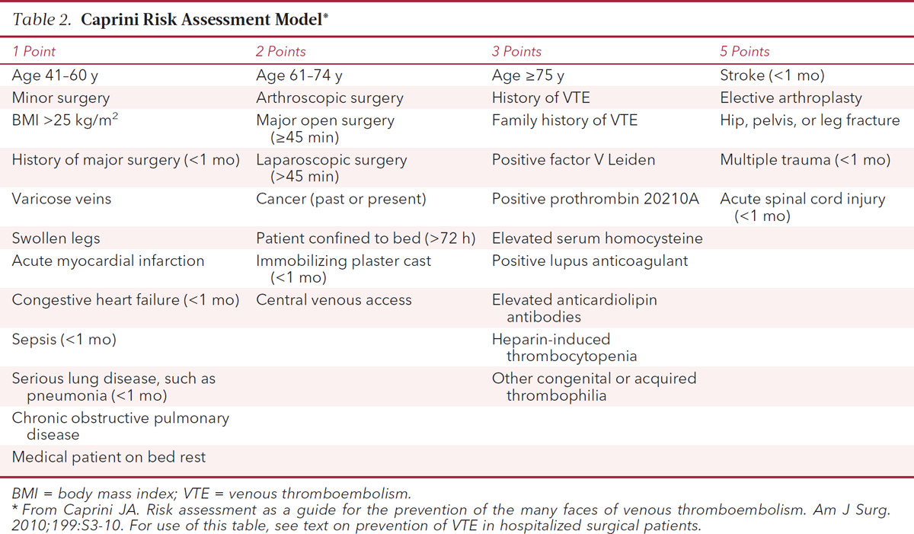
Predicting perioperative VTE risk
Caprini Score is the most widely used VTE risk prediction tool

Slide 31
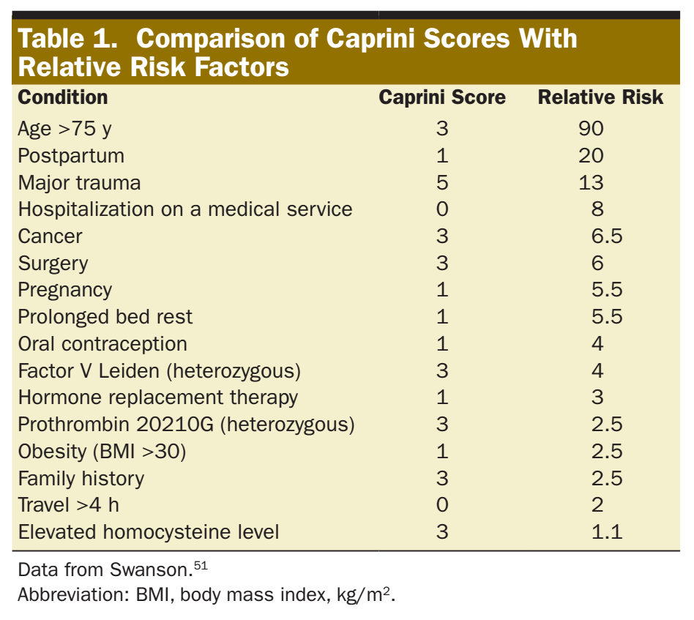

Slide 32
Preventing perioperative VTE
Anesthesiologists have make sure that patients receive optimum VTE prophylaxis
Multimodal therapeutic approach is required

Slide 33
Preventing perioperative VTE
Phamacological VTE prophylaxis
Preinduction and prolonged utilization of portable ICDs
Anesthetic and analgesic regimens should enable early and aggressive mobilization
Monitor ETCO₂

Slide 34
Intermittent Pneumatic Compression Devices(ICDs)
Cornerstone in VTE prevention
Generate pulsatile flow that effective than stockings
Effective as pharmacological prophylaxis without risk for bleeding

Slide 35
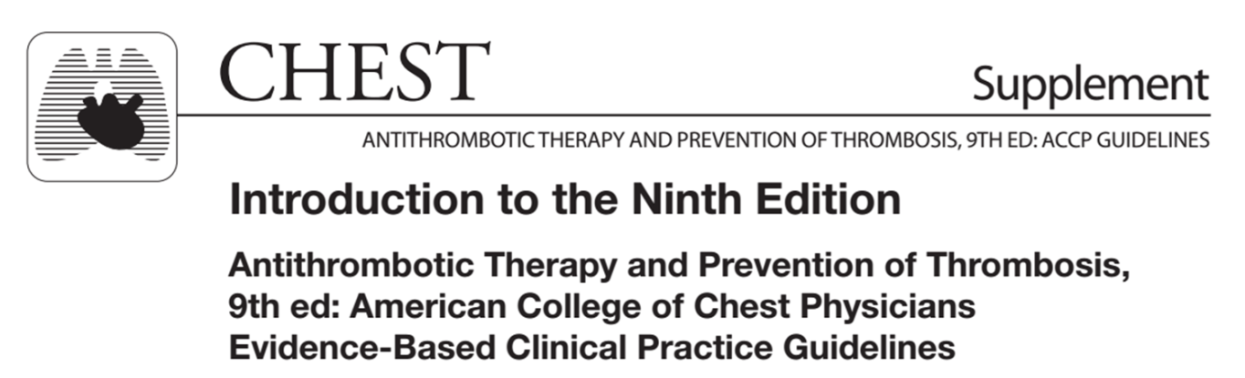
Intermittent Pneumatic Compression Devices(ICDs)
“For general surgery patients with a high risk of bleeding, we recommend the optimal use of mechanical thromboprophylaxis with properly fitted graduated compression stockings”

Slide 36
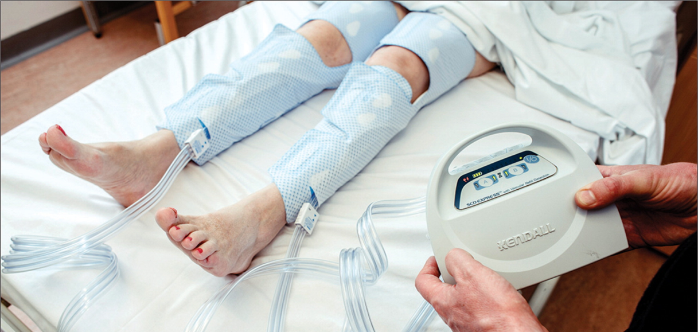
Intermittent Pneumatic Compression Devices(ICDs)
Mechanical ICDs thromboprophylaxis should be routinely administered to all patients at risk for VTE unless contraindicated

Slide 37
Contraindication of ICDs
Arterial insufficiency
Active phlebitis
Localized wound infection or cellulitis
Deep vein thrombosis

Slide 38
Aspirin
Primary role for the TF-triggered extrinsic clotting cascade and factor VIIa in thrombus initiation within the venous valve
Effective in preventing large thrombi than smaller thrombi and may decrease the severity of PE (prevent thrombus propagation)

Slide 39
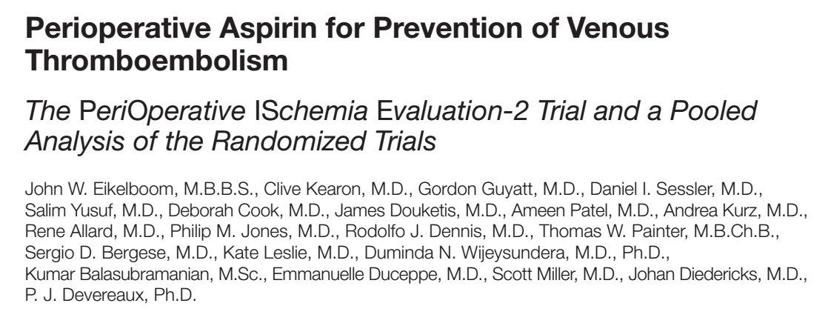
Aspirin

Slide 40
Novel Oral Anticoagulants
Potently inhibit factor Xa(such as rivaroxaban and apixaban) or thrombin(dabigatran)
Without the need for blood level monitoring

Slide 41
Novel Oral Anticoagulants
Alternative to current anticoagulants in perioperative VTE prophylaxis
Consequence of postoperative bleeding is the associated risk for infection of protheses

Slide 42
Statins
Inhibition of monocyte TF expression
Routine use of perioperative statins for VTE prophylaxis are still lacking and cannot be recommended

Slide 43
Intravenous lidocaine
Intravenous lidocaine, which is used as part of multimodal analgesic strategies
The clinical significance of this finding is still unknown, and the effects of intravenous lidocaine on VTE have not been studied

Slide 44
Neuraxial Blockade
Reduces the stress response and resulting cytokine release
Improvement in total venous blood flow

Slide 45
Preoperative genomic profiling

Slide 46
Preoperative genomic profiling
It is possible that future studies

Slide 47
CONCLUSIONS
Current prophylaxis guidelines have failed to eliminate the problem
Anticoagulant prophylaxis does not prevent venous stasis or venous valve endothelial activation

Slide 48
CONCLUSIONS
ICDs prophylaxis in all patients at risk as a first line of defense against thrombotic formation
ICDs should always start prior to the induction of general anesthesia or deep sedation
Anesthetic and analgesic regimens should enable early and aggressive mobilization

